Slide 1

Stanislav Ondruš Zuzana Jelčicová

Slide 2
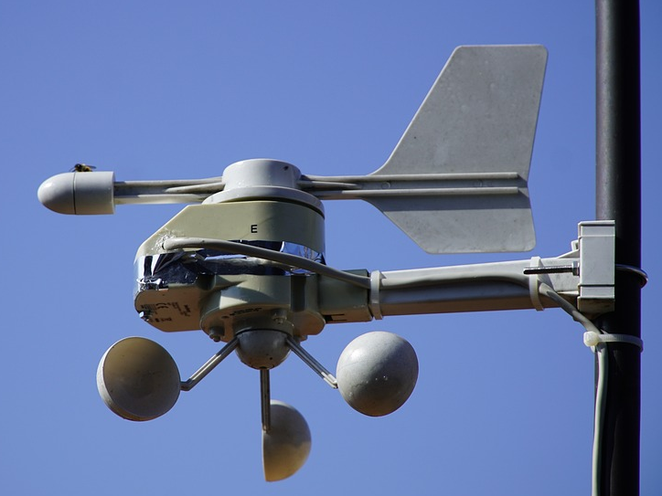
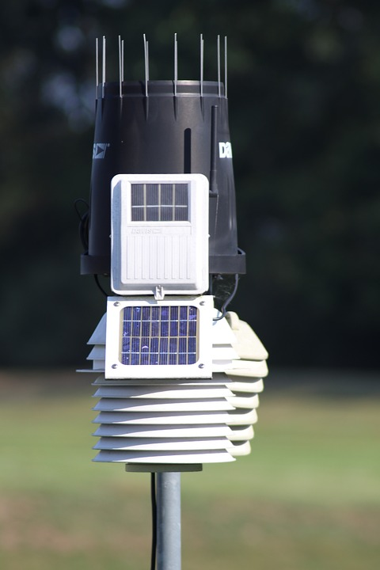
Wind and rainfall measurements – existing solutions
+ Simple
+ Easy to implement
- Moving parts
- Prone to failure
Anemometer
Tipping bucket

Slide 3
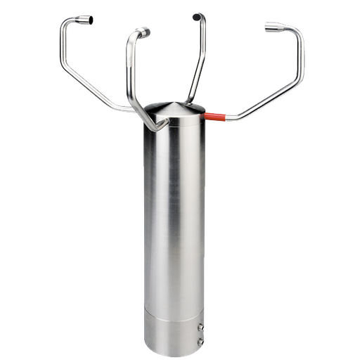
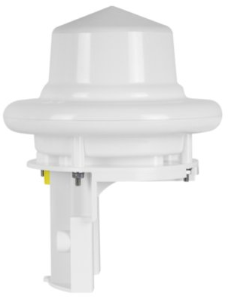
Wind and rainfall measurements – existing solutions
+ Maintenance free
- High cost
- Complex technology
Ultrasonic anemometer
Doppler radar

Slide 4
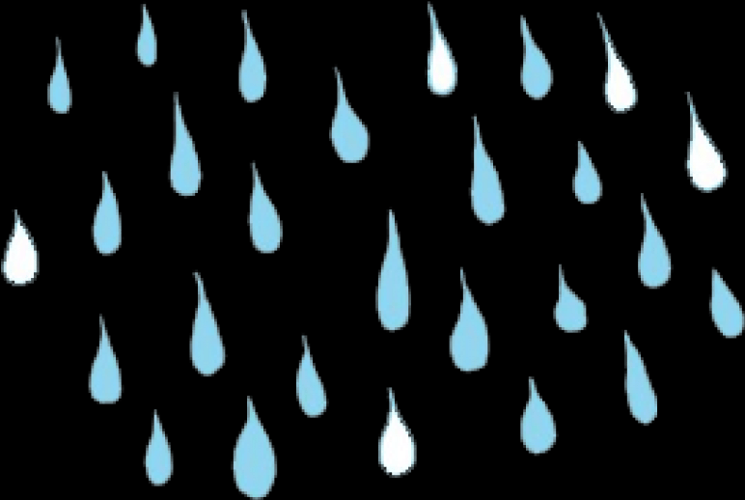

Wind and rainfall measurements – our solution
F
IMU

Slide 5
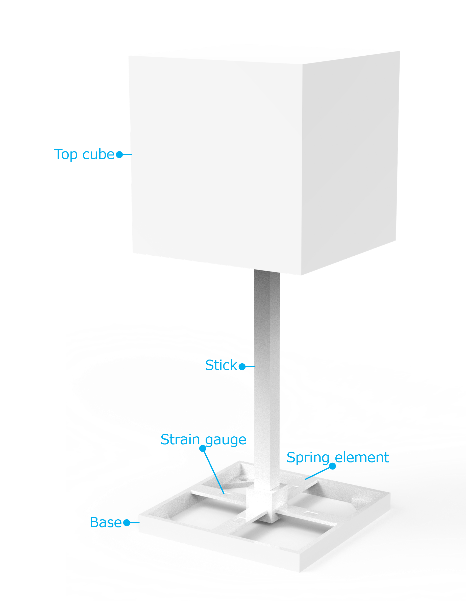
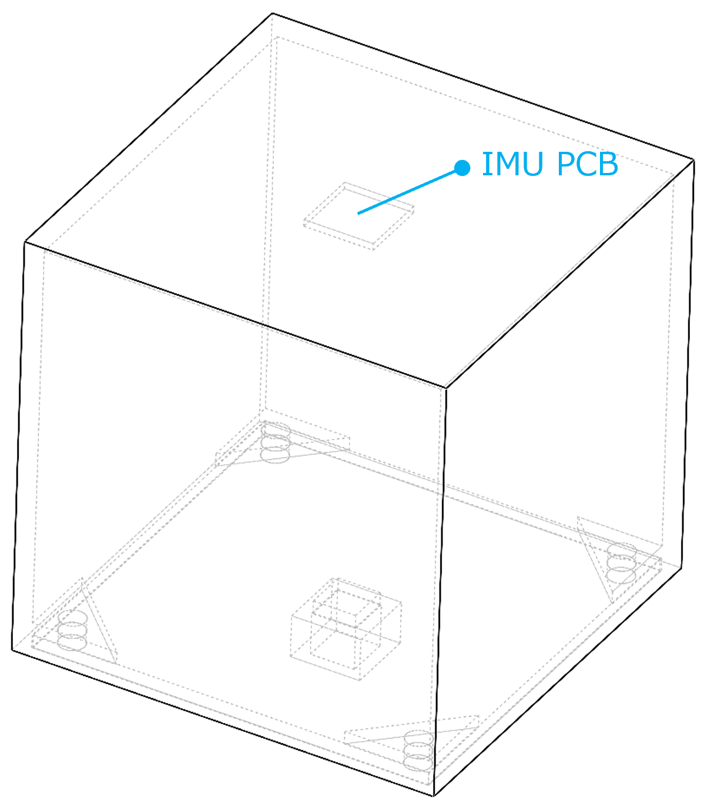
Prototype

Slide 6
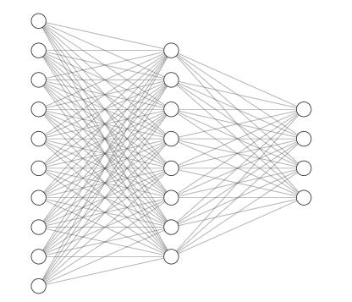
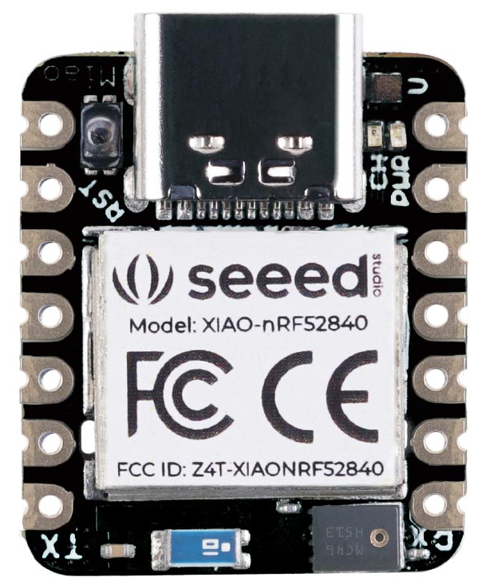
Neural network
+ Powerful
- Memory and computationally demanding → increased energy dissipation → draining battery
Requirement
Weather station (ideally) functioning for months on a small battery
Solution
Smaller and simpler network (FC layers)
Hybrid solution
Rain – neural network for rain classification
Proof of concept - 4 types of rain (accelerometer):
No rain
Light rain
Regular rain
Heavy rain
Model parameters: 31.6kB (8-bit data)
Wind – speed and direction calculated using 2-channel strain gauge data → faster and cheaper

Slide 7
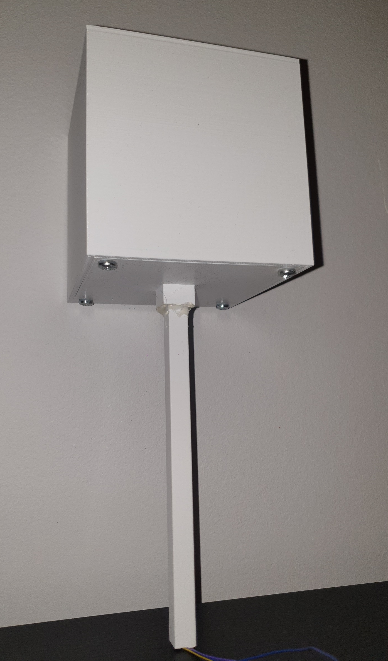
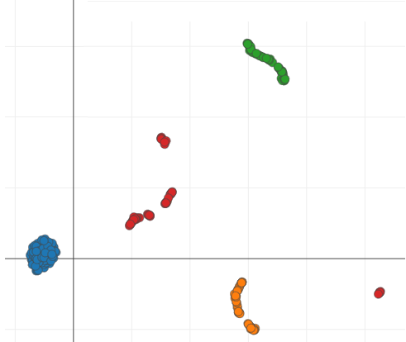
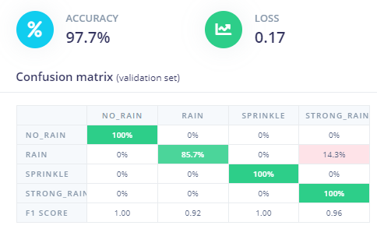
Data collection, preprocessing and training
Rain simulation → dispersed water stream at different flow rates and intensities
3D-printed prototype of the weather station responsible for rain data collection
The IMU (LSM6DS3TR-C) interfaced through I2C on XIAO nRF52840
Continuous streaming of 3-channel accelerometer data (250Hz)
Data stream captured over serial port on a PC
Data divided into training and test subset (80:20) → Edge Impulse
Accuracy: 97.7%, Latency: < 25ms (Cortex-M4F 64MHz in nRF52840)
Light rain
Heavy rain
No rain
Regular rain

Slide 8
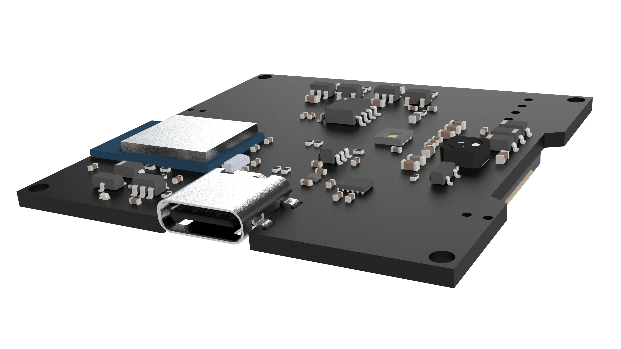
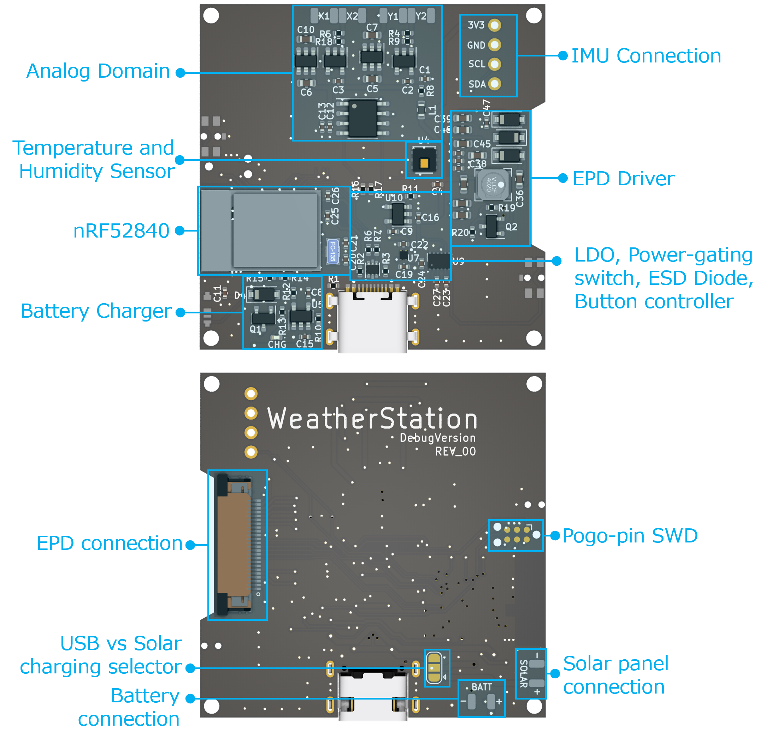
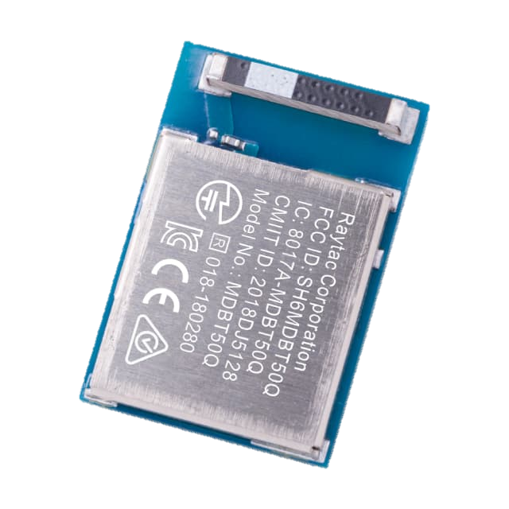
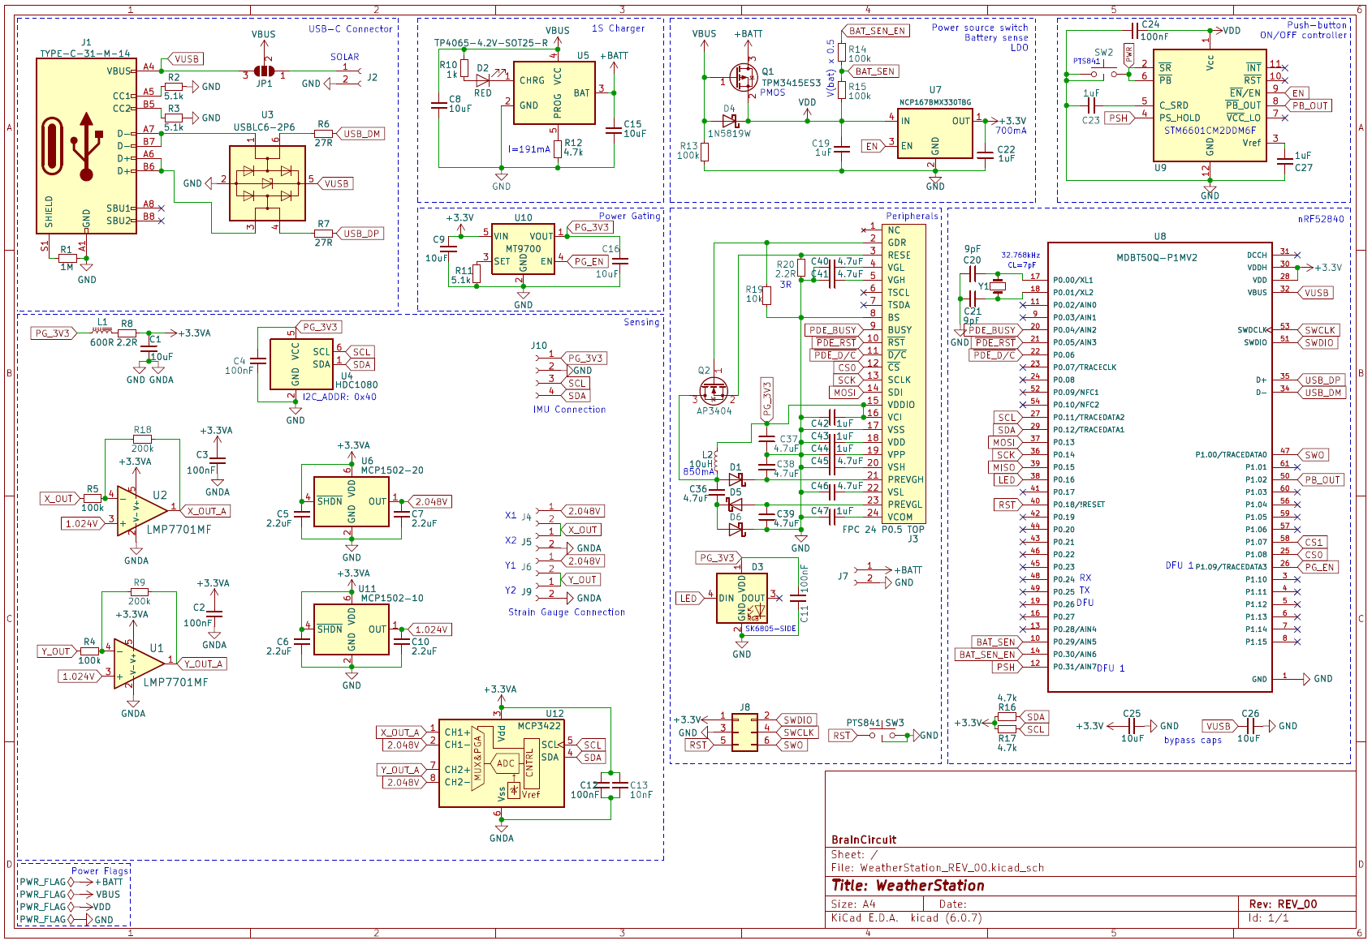
Custom PCB
nRF52840
Battery powered
Low power
Development version
BLE Advertising

Slide 9
Next steps
Sensing
Raindrop size and frequency - extracted from the accelerometer's AC content
Wind speed and direction - calculation based on strain gauge output
Hardware
Weather station assembly - material choice, shape optimization, DFM, etc.
Electronics - tests with the custom PCB

Slide 10
Thank you!

